Slide 1
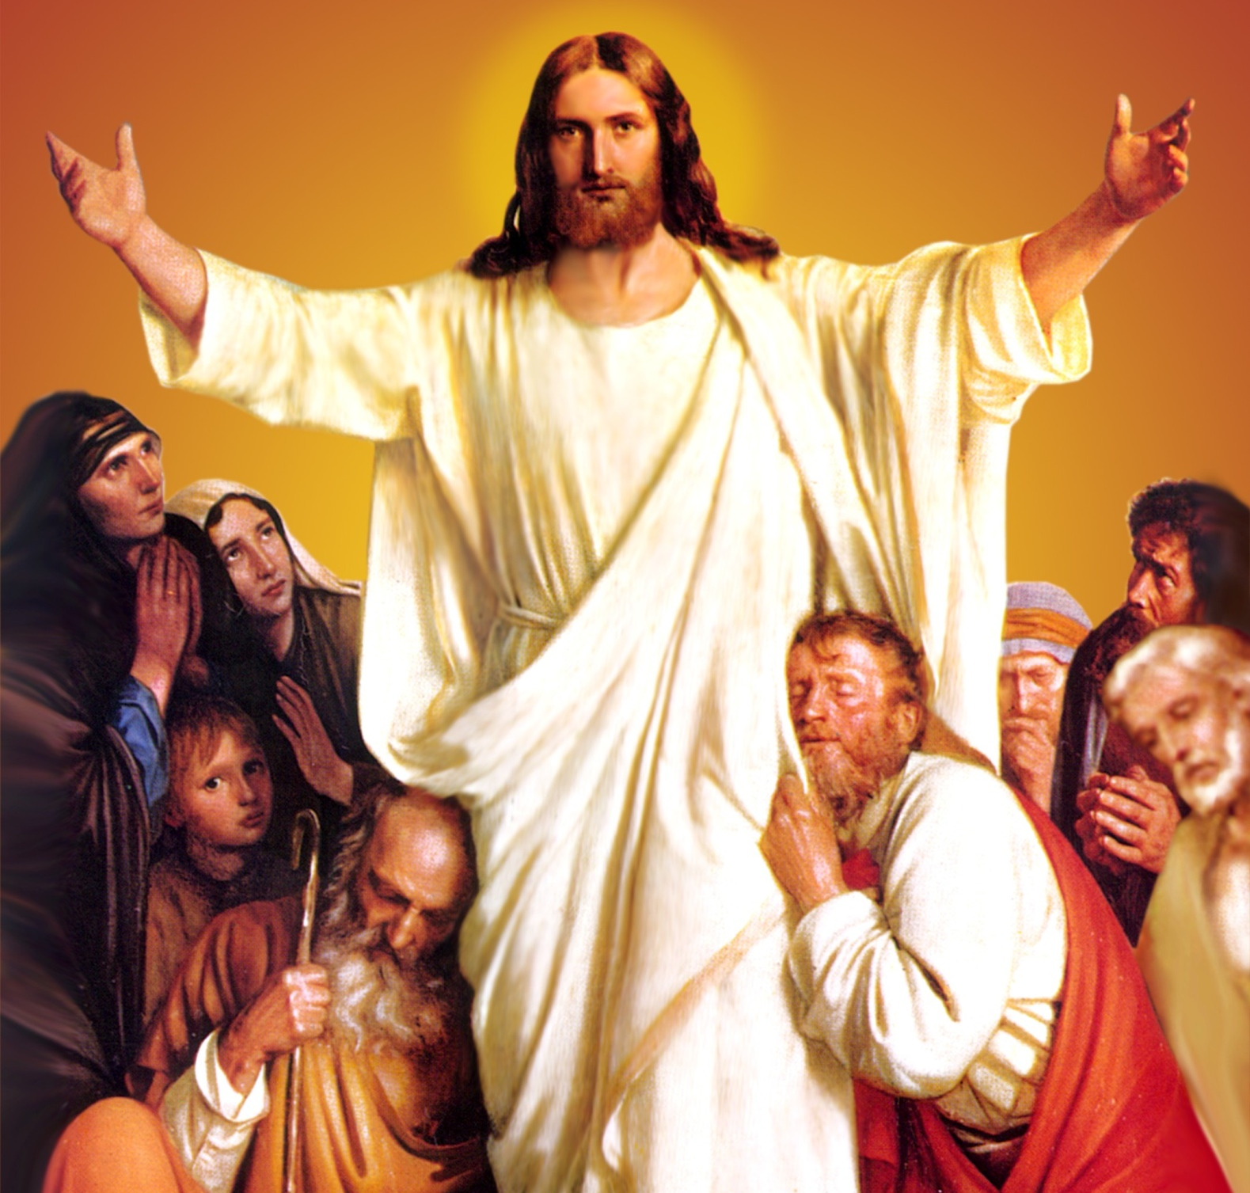
CATECHETICAL TEXTBOOK SERIES OF THE SYRO - MALABAR CHURCH
ON THE PATH OF SALVATION - 6
PEOPLE WHO
EXPERIENCED JESUS
6

Slide 2
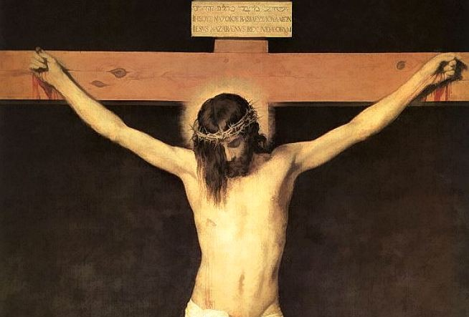
LESSON 8
JESUS WHO DIED FOR US

Slide 3
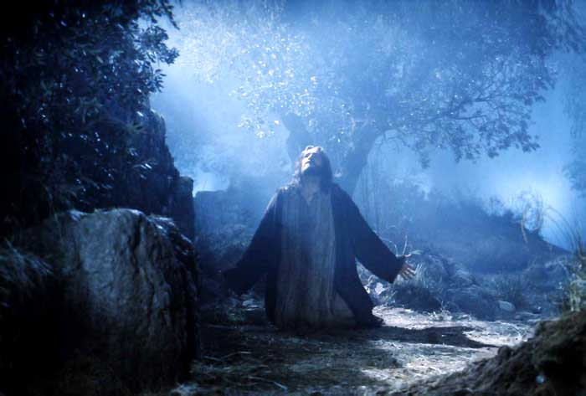
Realizing that the time was close for his sacrifice for the salvation of mankind, Jesus went to the Mount of Olives where he usually went for prayer. His disciples followed him. On reaching there he said to them, “Pray that you may not enter into temptation”. Then he withdrew from them about a stone's throw, knelt down, and prayed, “Father, if you are willing, remove this cup from me; yet, not my will, but yours be done” (Lk. 22: 42). Then an angel appeared from heaven, to strengthen him. Engulfed in severe pain he prayed more earnestly. His sweat fell on the ground as drops of blood. He suffered such mental agony. Yet, the Father decided not to remove the cup but to give him more strength to accept the suffering.

Slide 4
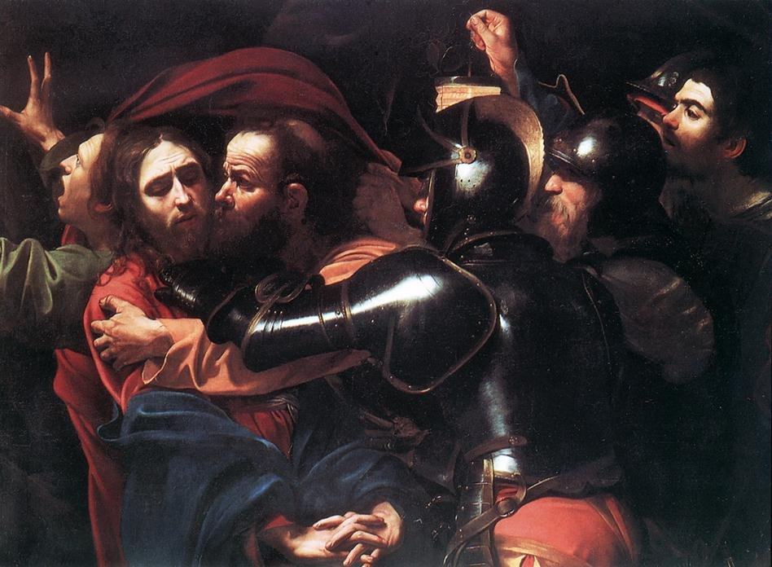
JUDAS BETRAYS JESUS
At this time Judas, one of the twelve disciples, came there with a party of soldiers and servants to apprehend Jesus. Judas came forward and kissed Jesus, as this was the pre-arranged signal of betrayal. Jesus asked, “Judas, is it with a kiss that you are betraying the Son of Man?” (Lk. 22: 48). The disciples who were with him ran away when they saw that Jesus was to be apprehended. The soldiers arrested Jesus.

Slide 5
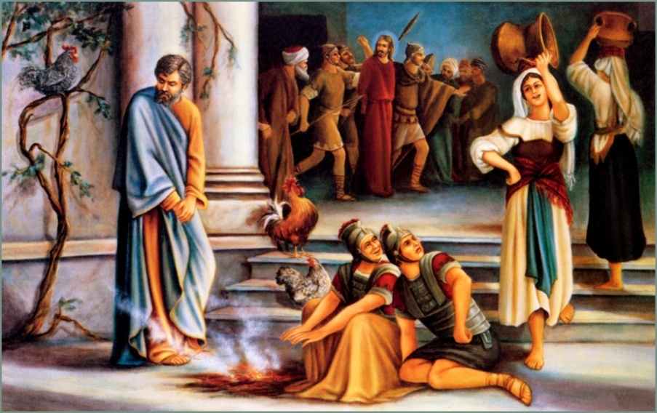
PETER'S DENIAL
'They seized Jesus and took him to the house of the chief priest. Peter had followed Jesus from a distance. When they had kindled a fire in the middle of the courtyard and sat down together, Peter also joined them. Then, a servant girl, seeing him in the firelight, stared at him and said; “This man also was with him.” But he denied it saying, “Woman, I do not know him.” A little later, someone else, on seeing him, said, “You also are one of them.”

Slide 6
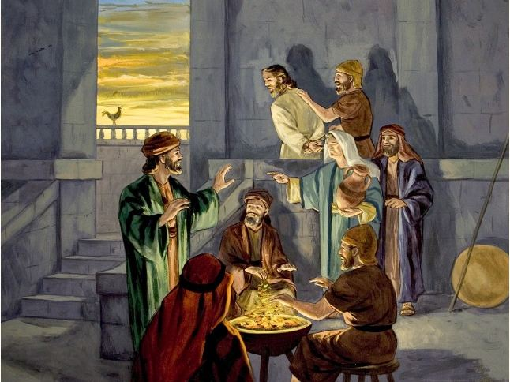
But Peter said, “Man, I am not!” Then, about an hour later still another kept insisting, “Surely this man also was with him, for he is a Galilean.” But Peter said, “Man, I do not know what you are talking about!” At that moment, while he was still speaking the cock crowed. The Lord turned and looked at Peter. Then Peter remembered the word of the Lord, how he had said to him, “Before the cock crows today, you will deny me three times.” And he went out and wept bitterly' (Lk. 22: 54- 62).

Slide 7
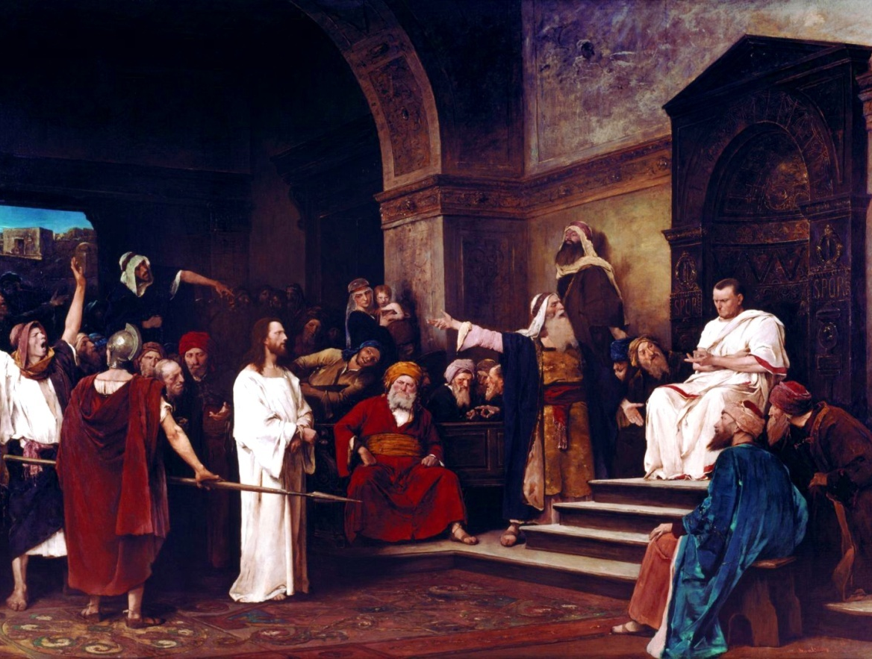
BEFORE PILATE
They brought three accusations against Jesus when they brought him before Pilate. They said, “We found this man perverting our nation, forbidding us to pay taxes to the emperor, and saying that he himself is the Messiah, a king” (Lk. 23: 2). Hearing this Pilate asked Jesus, “Are you the king of the Jews?” Jesus said, “My kingdom is not from this world.
If my kingdom were from this world, my followers would be fighting to keep me from being handed over to the Jews” (Jn. 18: 36). Pilate understood that Jesus was innocent and that he was handed over by jealousy. He wished to set Jesus free. They had a custom of setting free one prisoner on the pass over feast. So Pilate asked them, “Shall I set free the king of the Jews?” But the people clamoured to set free Barabas and to crucify Jesus. Seeing that his attempts were not effective, Pilate washed his hands in front of the people saying, “I am innocent of this man's blood” (Mt. 27: 24). Then Pilate set free Barabas and handed Jesus over to be crucified after having him whipped.

Slide 8
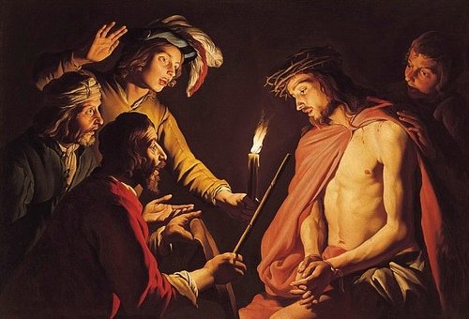
JESUS IS MOCKED
Then the soldiers took Jesus to the court-yard of the palace. They stripped him and put a scarlet robe on him. After twisting some thorns into a crown, they put it on his head and put a reed in his right hand. They then knelt before him and mocked him saying, “Hail, King of the Jews!” They slapped him, spat on him and took the reed from him and struck him on the head.

Slide 9
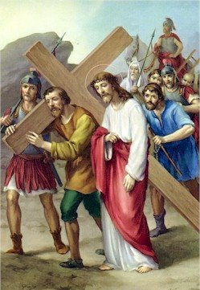
THE JOURNEY TO CALVARY
Jesus was made to go to Calvary carrying his cross. On the way, the soldiers continued to torture him. Fearing that he would not reach Calvary alive, if he had to carry the heavy cross, they made Simeon of Cyrene carry it behind Jesus. To the women who cried, seeing him in this condition, he said, “Daughters of Jerusalem do not weep for me. Weep for yourself and your children” (Lk. 23: 28).

Slide 10
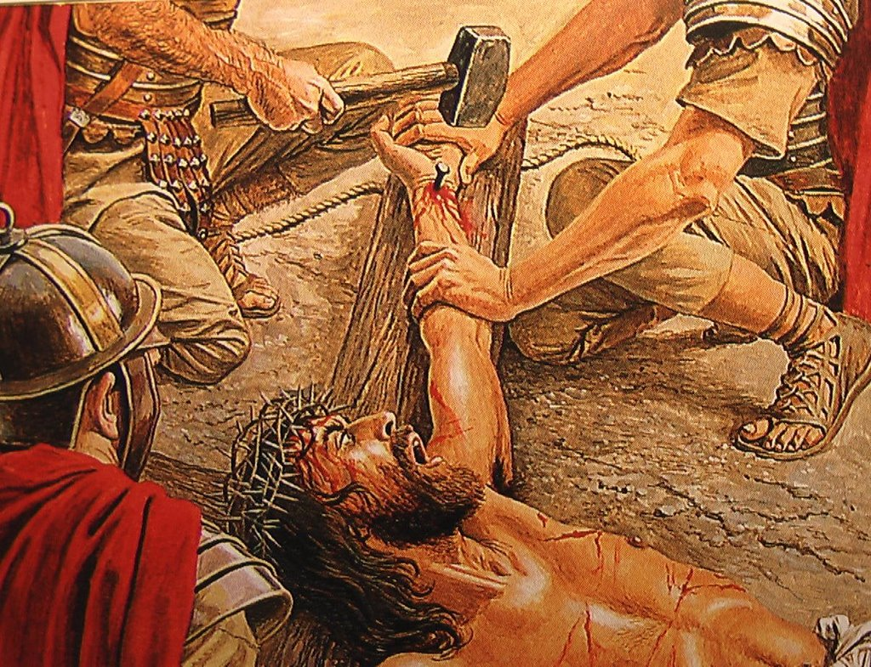
JESUS DIES ON THE CROSS
When they reached Golgotha, they made Jesus lie on the cross, nailed his hands and feet to the cross and raised the cross. They took his clothes and divided them into four parts, one for each soldier. Since his tunic was seamless, they put a lot on it to see who should get it. The soldiers and the people mocked Jesus even when he was on the cross. They challenged him to come down from the cross. Jesus endured all this silently.

Slide 11
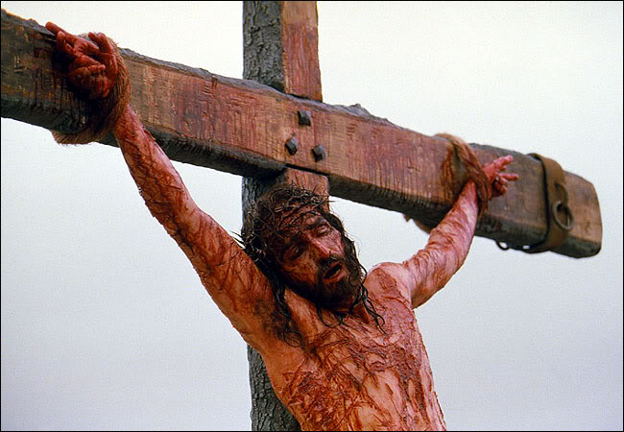
From the sixth hour (noon) to the ninth hour the whole land was covered in darkness. About the ninth hour, crying in a loud voice, Jesus said, “Father into your hands I commend my spirit” (Lk. 23: 46). With this he breathed his last and offered up his soul. At that time, the curtain of the temple was torn into two from top to bottom, the sun darkened, the earth shook and the rocks split.
The centurion who was watching all this praised God and said, “Truly this man was innocent.” Jesus suffered torment and died on the cross for us. The death of Jesus attained for us absolution from our sins, and salvation. Now, whenever we sin we are hurting Jesus.

Slide 12
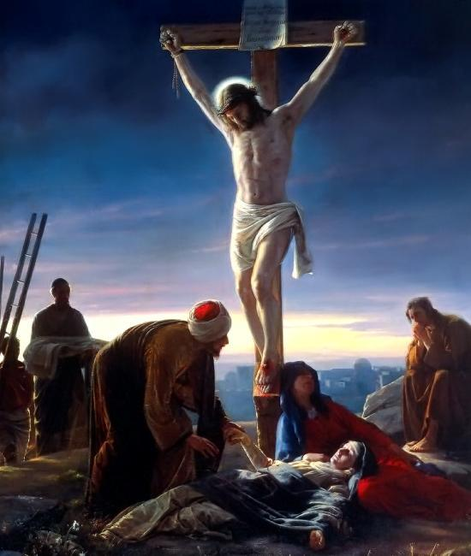
During the Holy Mass when the priest approaches the centre of the altar with the host and wine in the chalice and cup, that reminds us of the journey of Jesus to Calvary. During the prayer that follows, the priest holds his hand like a cross. This reminds us of the crucifixion of Jesus. Whenever we participate in the Holy Mass, let us prayerfully thank Jesus who died for us.

Slide 13
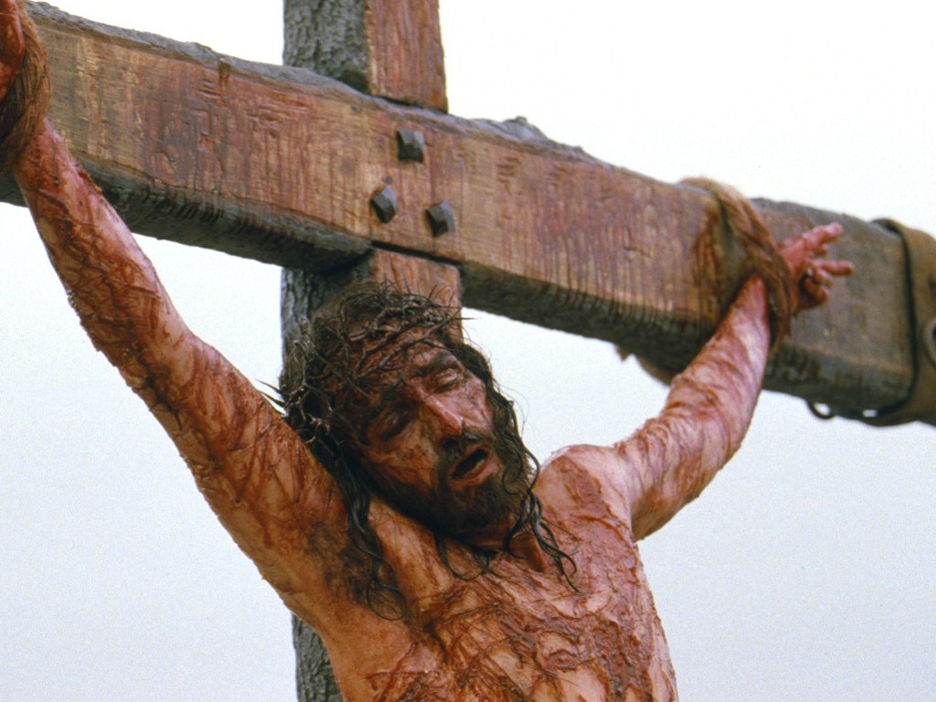
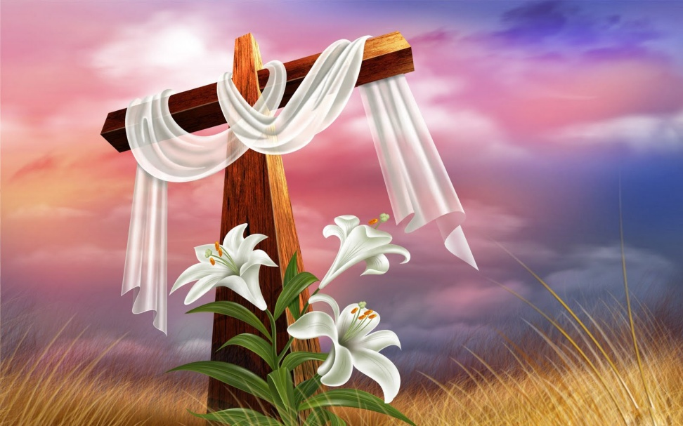
GOOD FRIDAY
Good Friday is the day of the holy week that commemorates the passion and the crucifixion of Jesus. The Church observes this day with various ceremonies. Reading of the passion narrative, veneration of the cross, drinking the bitter juice, the way of the cross, and procession of penance, form part of the Good Friday ceremonies.
“For God so loved the world that he gave his only son, so that every one who believes in him may not perish but may have eternal life” (Jn. 3: 16). God the father sent his only son into this earth for the purpose of redeeming the world. Jesus obtained salvation for us by offering himself as a sacrifice on the cross in atonement for our sins. Let us enjoy the fruits of this redemption, by keeping away from the ways of sin.

Slide 14
Let us pray
O! Jesus, who sacrificed yourself for our salvation and asked us to commemorate your passion, death and resurection, help us to benefit the fruits of your divine mysteries.

Slide 15
Read the word of god:
Luke 22:39-53

Slide 16

WORD OF GOD FOR GUIDANCE
"Father, not my will but yours be done."(Lk. 22:42).

Slide 17
LET US DO:
Find out and write the seven sentences uttered by Jesus
on the cross, by checking the passion narratives in the four Gospels.

Slide 18
MY DECISION
I will pray to Jesus who died for me, for the grace
to lead a life without committing sins.

Slide 19
LET US Find out the answer
1. What was the prayer of Jesus at Gethsemane?
2. What was the answer given by the Father in response to Jesus' Prayer?
3. What did Jesus ask Judas who came to betray him?
4. What change happened to Peter when Jesus looked at him after he had denied Jesus thrice?
5. What did the centurion who stood at the foot of the cross say, having seen the death of Jesus?
6. When do we commemorate the passion and death of Jesus in the Holy Qurbana?

Slide 20
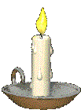


Thank you

